Slide 1
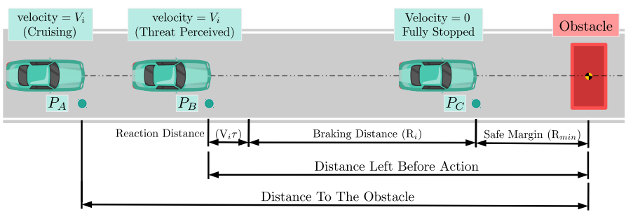
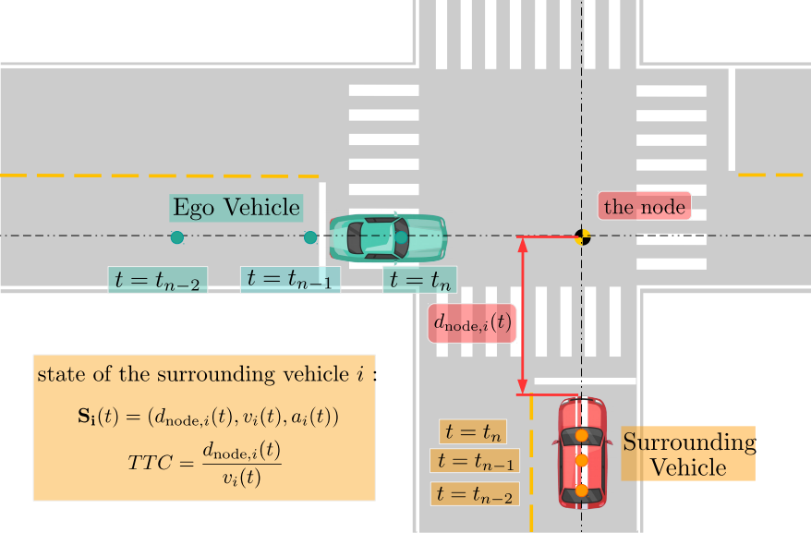
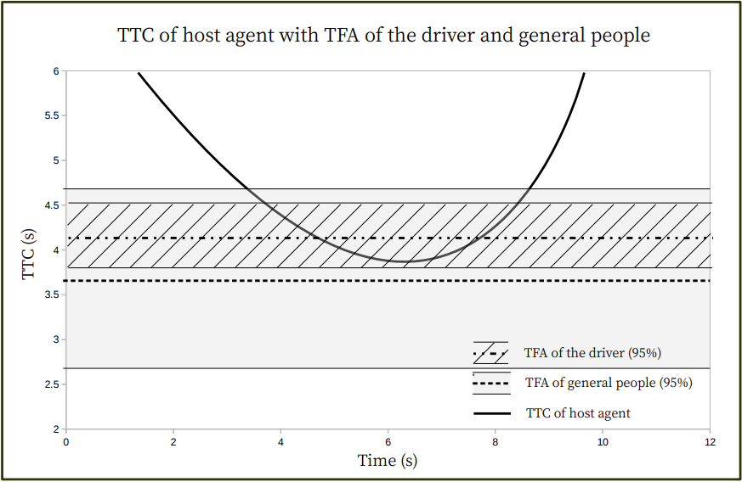
Probabilistic Modeling of Driver Behaviors At Urban Crossroads
Braking up and formulating drivers’ braking process.
Model of drivers behavior at crossroads, the center of the crossroad is noted as “the node”.
Model drivers’ braking decision in a probabilistic way.
Yuan Cheng Liu, Kuei Yuan Chan 2019

